Slide 1


Sea-level change: Why seasons matter!
Tim Hermans (Postdoc @ IMAU)
t.h.j.hermans@uu.nl

Slide 2

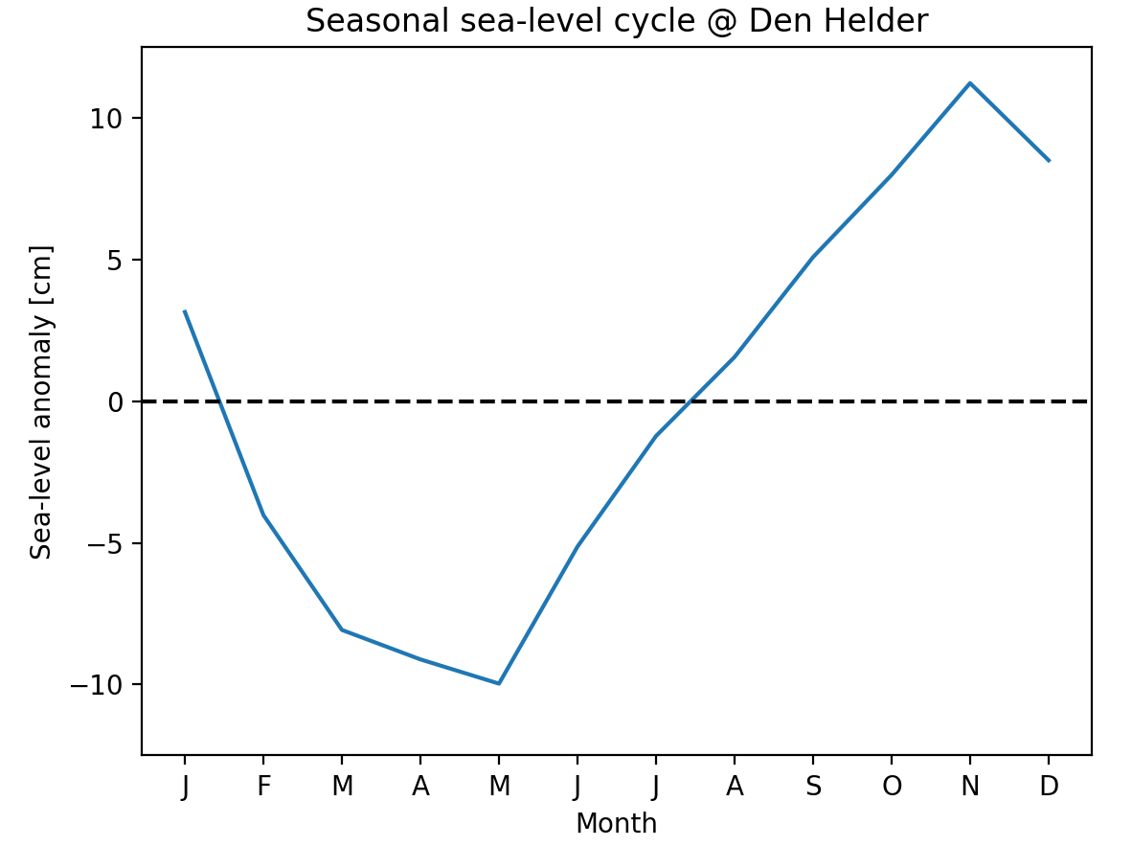
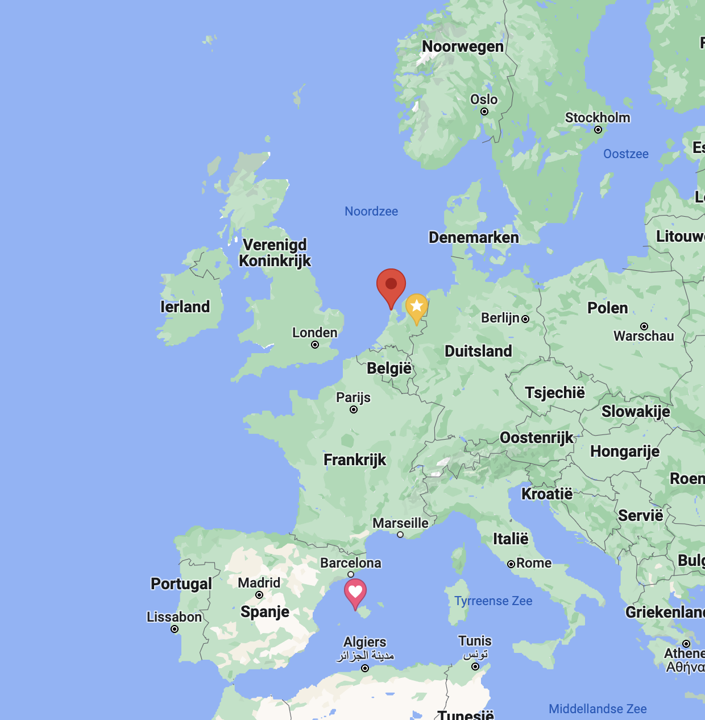

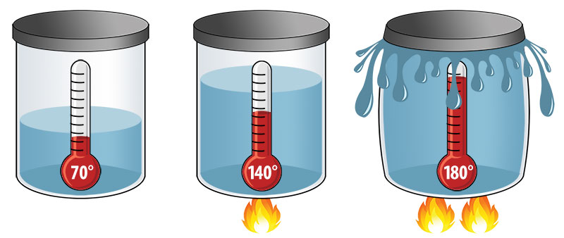
Group by month
Den Helder!
Reasons?
Notes:
Ask class ideas why?

Slide 3


Slide 4
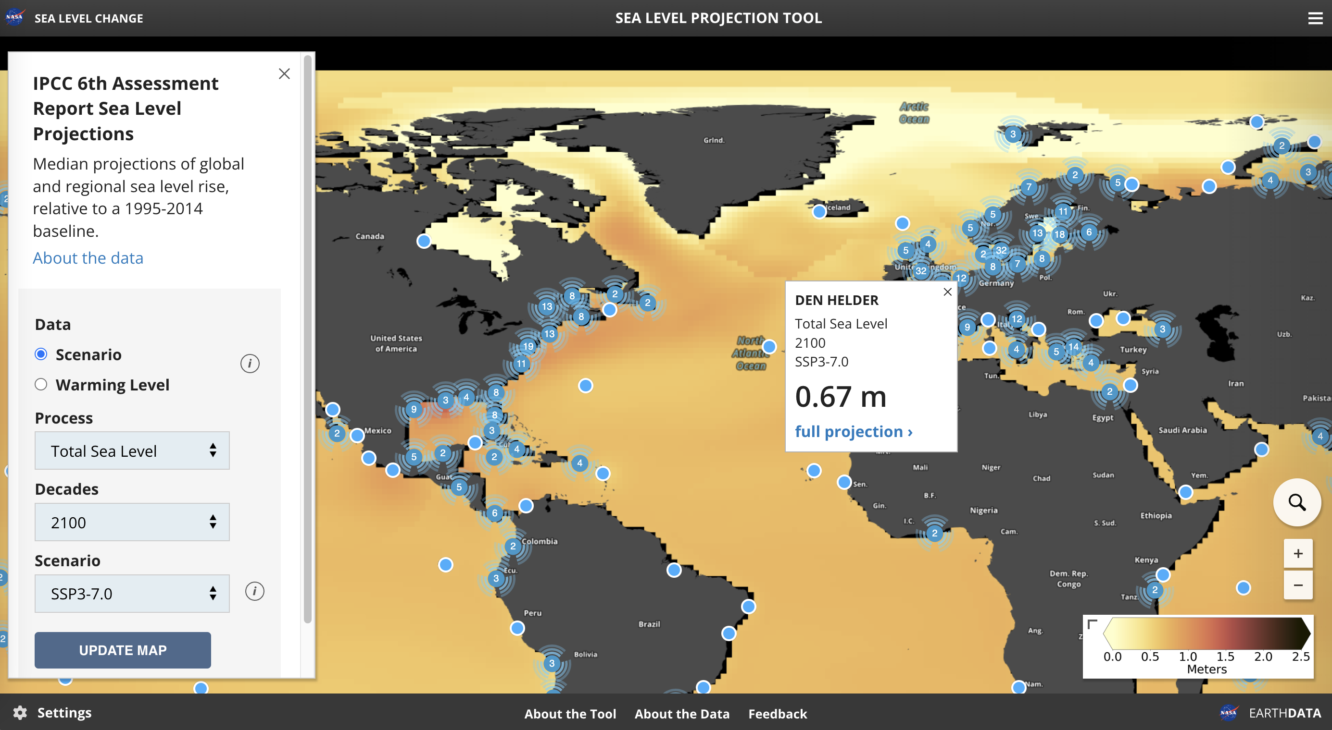
NASA Sea-level tool

Slide 5
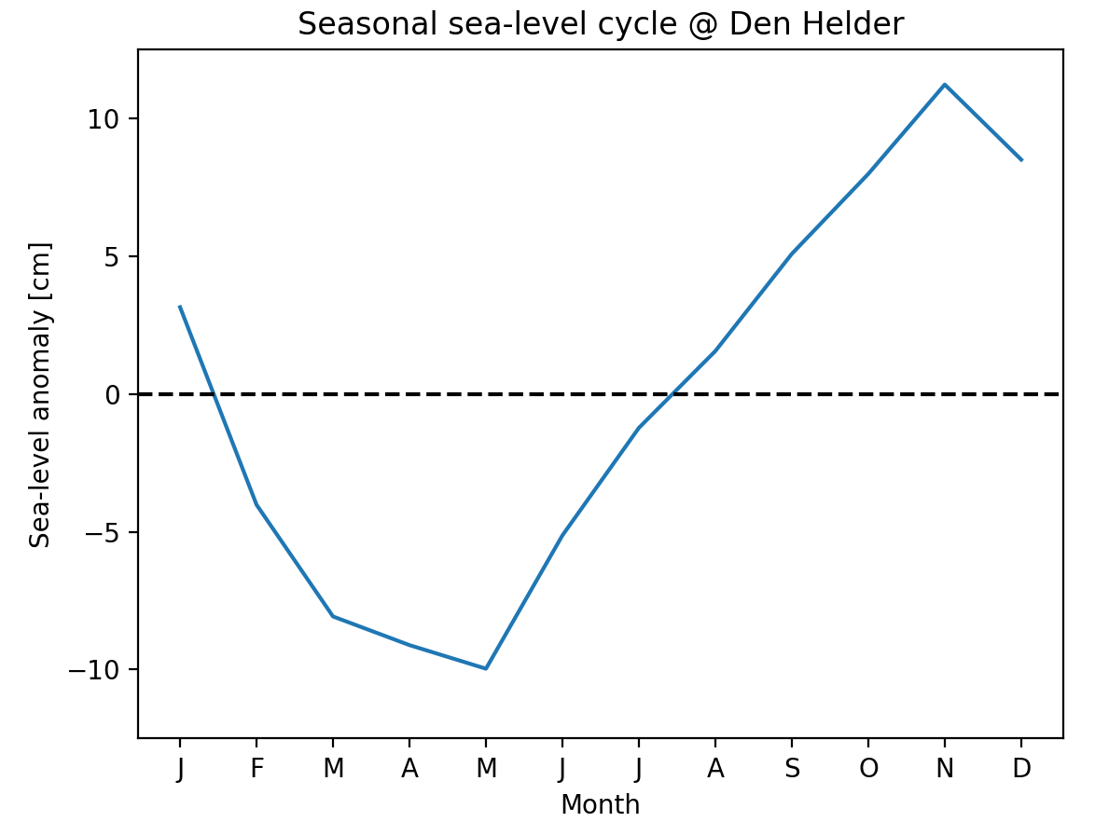
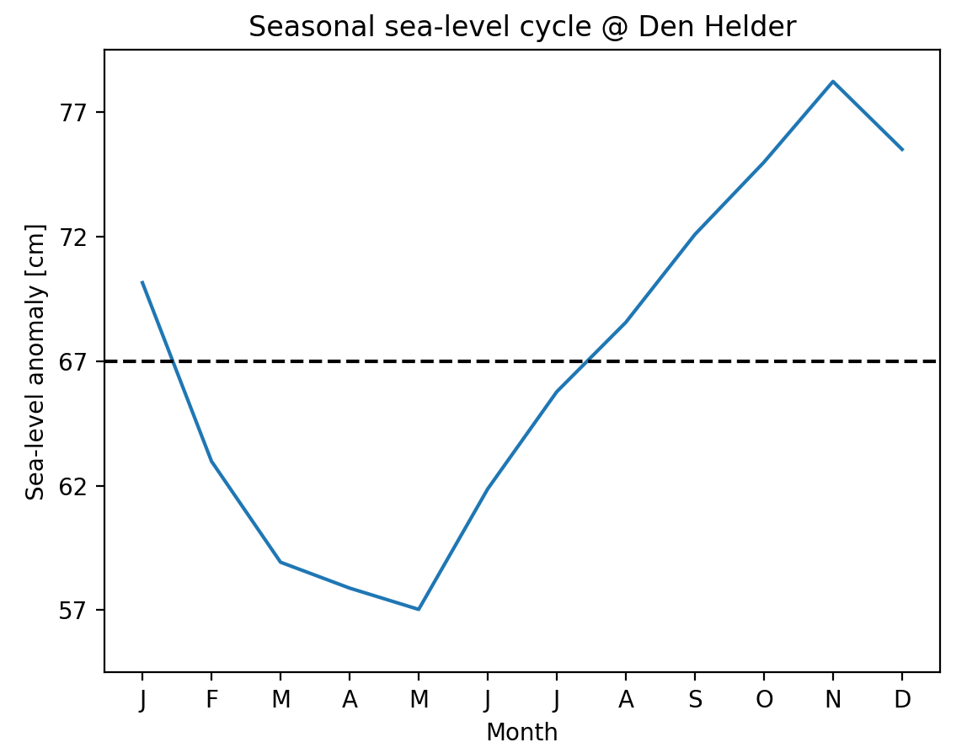

?
> 67 cm?
2100?
+ 67 cm
< 67 cm?
Notes:
Ask students: what do you think we need to answer this question?

Slide 6
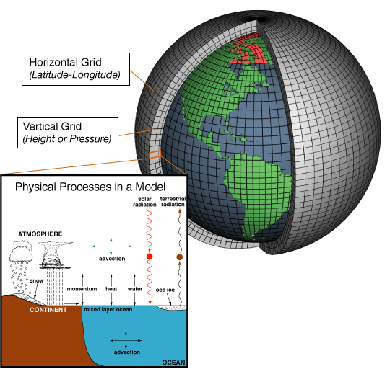

Climate model simulations
x 30!
Global climate model
Scenario
Simulations of sea level
(among others!)
Notes:
High emissions scenario to have the largest signal

Slide 7
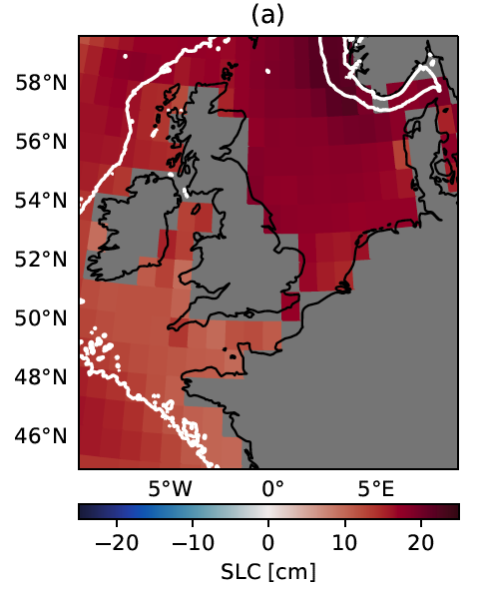
Projected ‘ocean dynamic’ sea-level change
Mean of all models
Ocean dynamic sea-level change [cm]

Slide 8
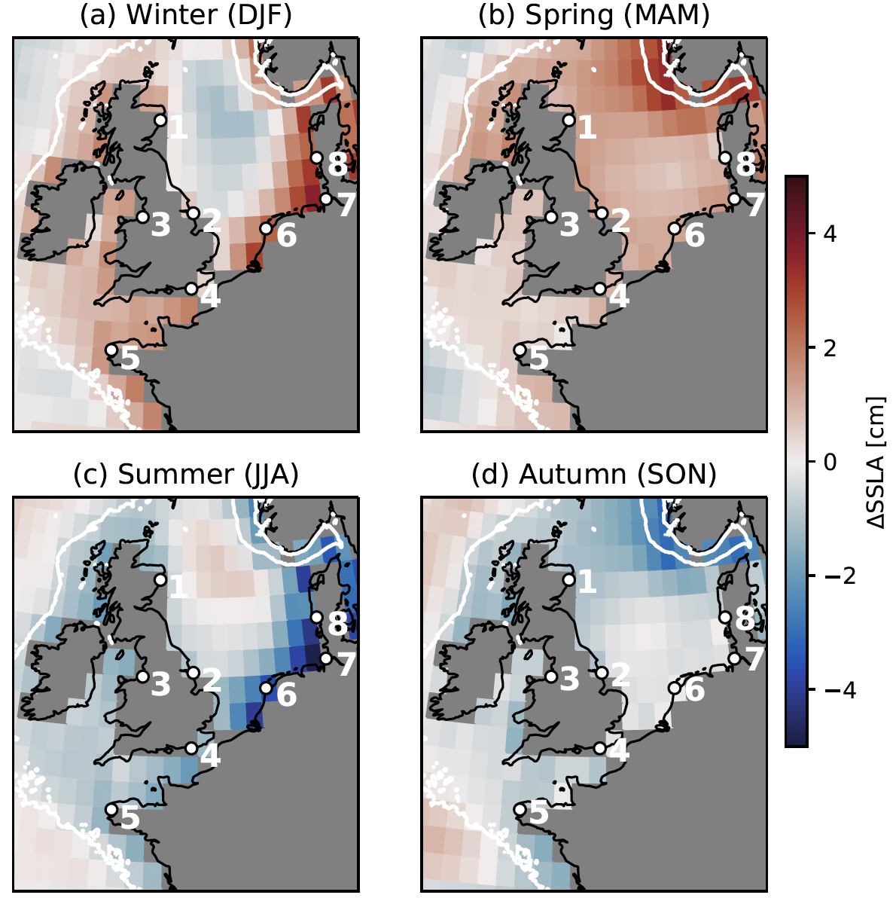
How much more/less in seasons?
Winter (DJF)
Spring (MAM)
Mean of all models
+
Summer (JJA)
Autumn (SON)
Additional sea-level change [cm]
Ocean dynamic sea-level change [cm]
Notes:
Vragen: stel door de wind / ekman transport, welke richting zou wind moeten toenemen?

Slide 9
cause?
Winter (DJF)
Spring (MAM)
Ekman
transport
Summer (JJA)
Autumn (SON)
Additional sea-level change [cm]
Ekman
transport
Additional wind-stress change [N/m²]

Slide 10
Additional change in winter:
3 examples
x 30!
Model 1
Model 2
Model 3
Additional wind-stress change
Additional sea-level change [cm]

Slide 11
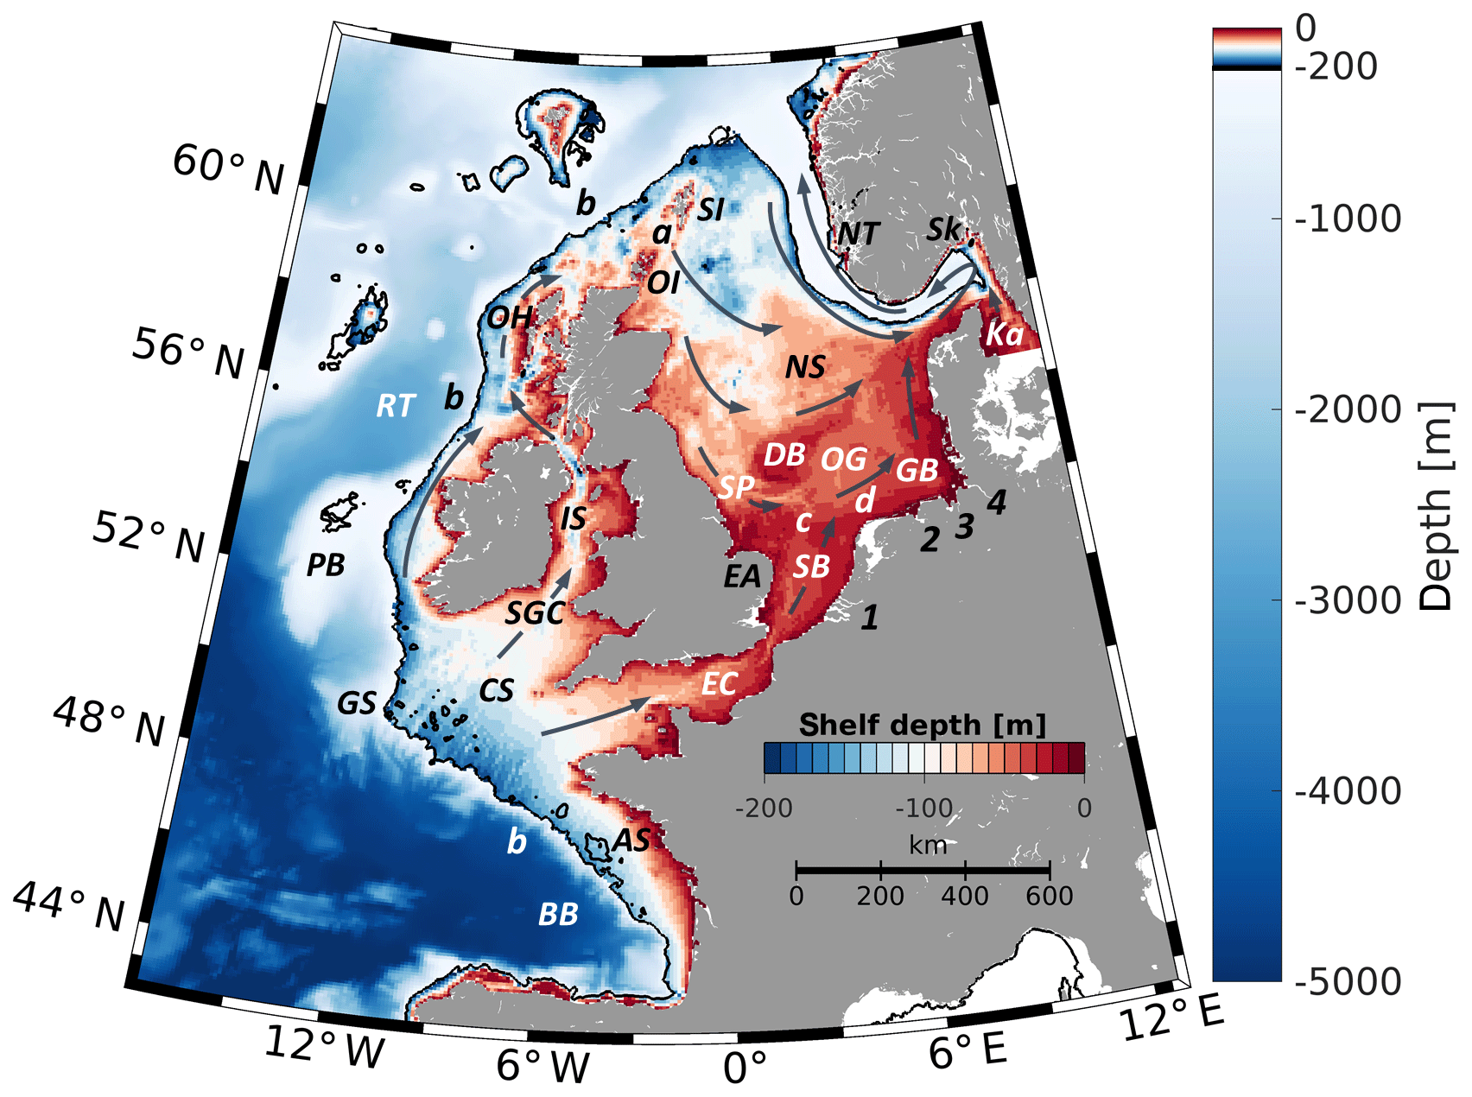
Isolating effect of the wind
Model 1
Model 2
Model 3
Take the wind change
Apply to regional ocean model
Additional wind-stress change
Additional sea-level change [cm]
Simulate effect of wind change
Currents change due to wind change
Sea-level change due to wind change [cm]

Slide 12
Conclusions
Sea-level rise in Europe differs between seasons
Higher in winter & spring
Lower in summer & autumn
Causes:
Winter & summer: wind-stress change
Spring & autumn: density changes?
Relevant for instance for intertidal ecosystems

Slide 13
Topics for MSc thesis
Global climate models
Regional ocean modeling
Seasonal changes in sea level
Performance
Downscaling global models
Changes in storm surges & tides
t.h.j.hermans@uu.nl

Slide 14
Extra

Slide 15
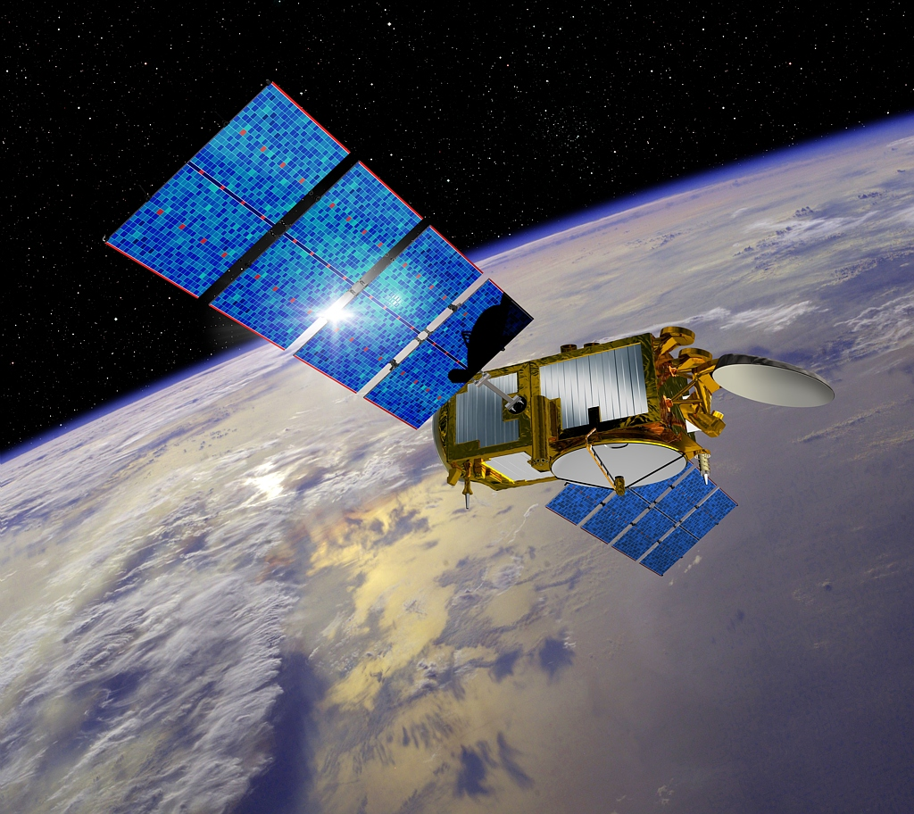
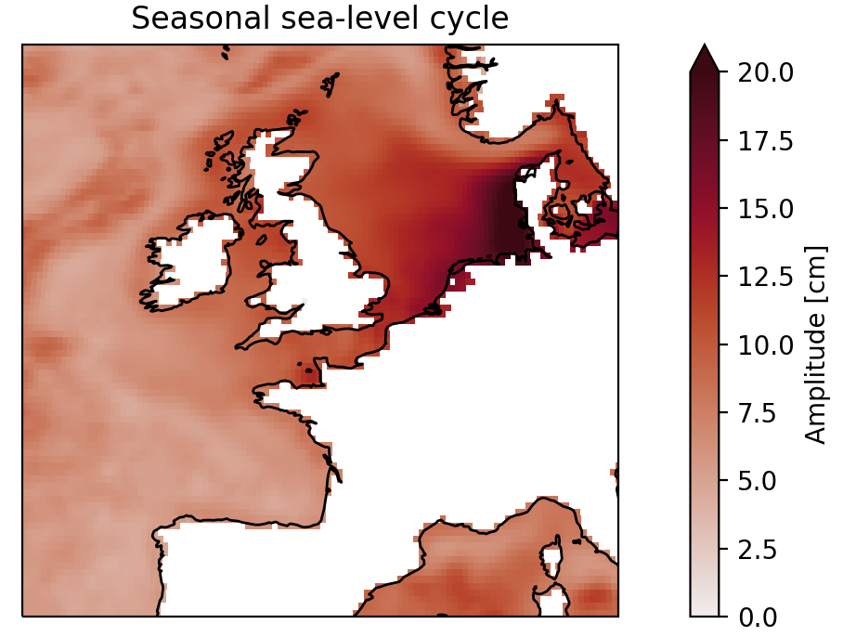
What satellites see:
(PS: same data as in python assignment 7.2! 1995-2015)

